Slide 1

UNESCO

Slide 2
UNESCO In Brief
United Nations Educational
Scientific and Cultural Organization

Slide 3
What is UNESCO?
UNESCO is the United Nations Educational, Scientific and Cultural Organization. It seeks to build peace through international cooperation in education, sciences and culture. UNESCO's programmes contribute to the achievement of the Sustainable Development Goals defined in the 2030 Agenda, adopted by the UN General Assembly in 2015.

Slide 4
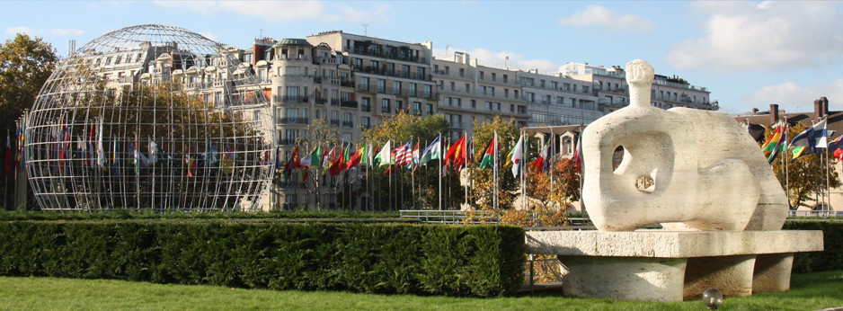
LOCATION
UNESCO Headquarters are located at 7, place de Fontenoy in the heart of Paris.

Slide 5
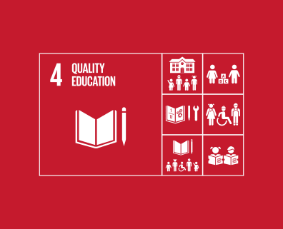
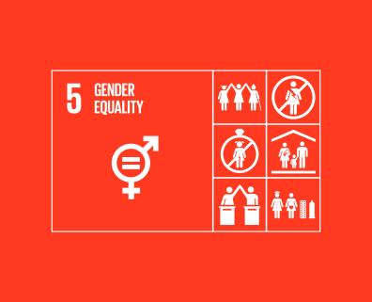

Slide 6
UNESCO Goals
1- Achieve good education for all and provide access to lifelong learning.
2- Running Science policy and knowledge for sustainable development.
3- Addressing emerging social and ethical challenges.
4- Promoting cultural diversity, intercultural dialogue and a culture of peace.

Slide 7
UNESCO history
established after World War II, when the governments of European countries that were fighting Germany and its allies met in Britain.
The purpose of this meeting was to find a way in which they could re-establish safety and rebuild educational systems after the end of the World War.

Slide 8
facts
UNESCO is the United Nations Educational, Scientific and Cultural Organization (UNESCO)The abbreviations refer to the United Nations Educational, Scientific and Cultural Organization (UNESCO).
A United Nations specialized organization based in Paris, founded in 1945, became a United Nations organization in 1946. It has 195 members and 8 associate members. The policies of the Organization are determined at a biannual conference, consisting of one representative for each member.

Slide 9
UNESCO program
1- UNESCO promotes education as a means of economic and social development throughout the world, "Education for All" is the largest program to expand care early childhood education, free education for all children,
Illiteracy for adults, and the development of universal educational standards in reading and mathematics.
2- UNESCO's natural sciences sector organizes international programs and research in the fields of science, engineering and renewable energy. Its programs aim to respond to the scientific aspects of international issues such as climate change and poverty. This sector focuses on natural disasters and on underdeveloped countries, particularly in Africa.

Slide 10
3- UNESCO's Cultural Program is responsible for the protection and management of the world heritage in all its forms. The list of World Heritage sites established in 1972 is one of the most important programs of the cultural sector. UNESCO defines heritage in six categories: cultural, natural, tangible, intangible, movable, Movable.
4- The mission of the Social and Human Sciences Sector of UNESCO is to improve the social conditions of member countries by promoting intellectual cooperation in the values of justice and freedom. Through this program, UNESCO supports human rights and fights all forms of discrimination to ensure human rights throughout the world.

Slide 11
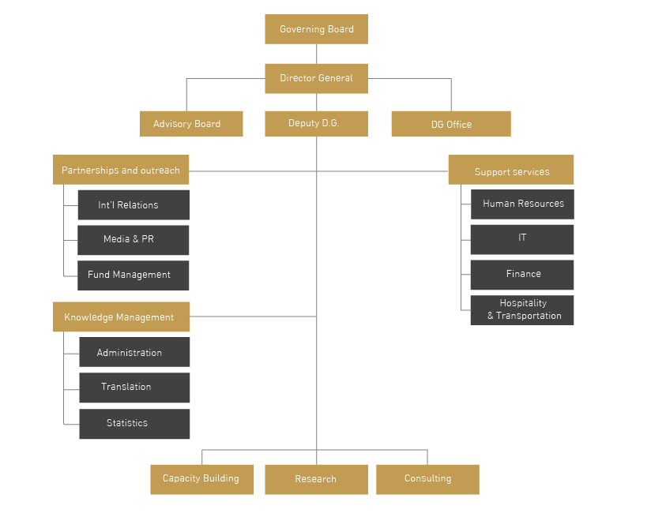

Slide 12
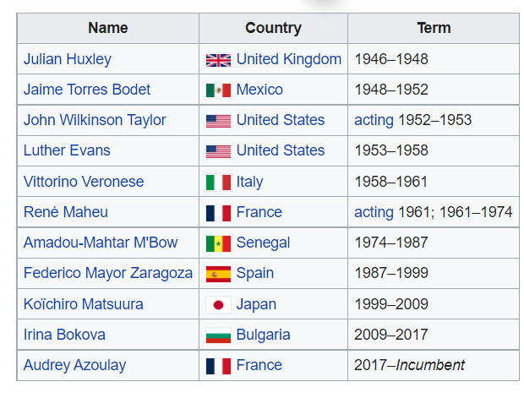
Director-General

Slide 13
Member states
As of January 2019, UNESCO has 193 member states and 11 associate members.
Some members are not independent states and some members have additional National Organizing Committees from some of their dependent territories

Slide 14

Formation 16 November 1945; 76 years ago
Headquarters World Heritage Centre Paris, France
Head Director-General Audrey Azoulay
Parent organization
United Nations Economic and Social Council

Slide 15
Regional Office in Cairo
UNESCO Cairo Office, established in 1947, is the Regional Bureau for Sciences in the Arab States. It is also the Cluster Office for Egypt, and Sudan. The UNESCO Cairo Office is one of 52 field offices worldwide.

